Slide 1
DAT 560M
Final Presentation
Yifei Hu 491843
Xiaoxiang Liang 489743
Qinyi Liu 489537
Jingdi Han 489554

Slide 2
Data Description
Problem Statement
CONTENTS
Methods&Results
Conclusion

Slide 3
01
DATA DESCRIPTION

Slide 4
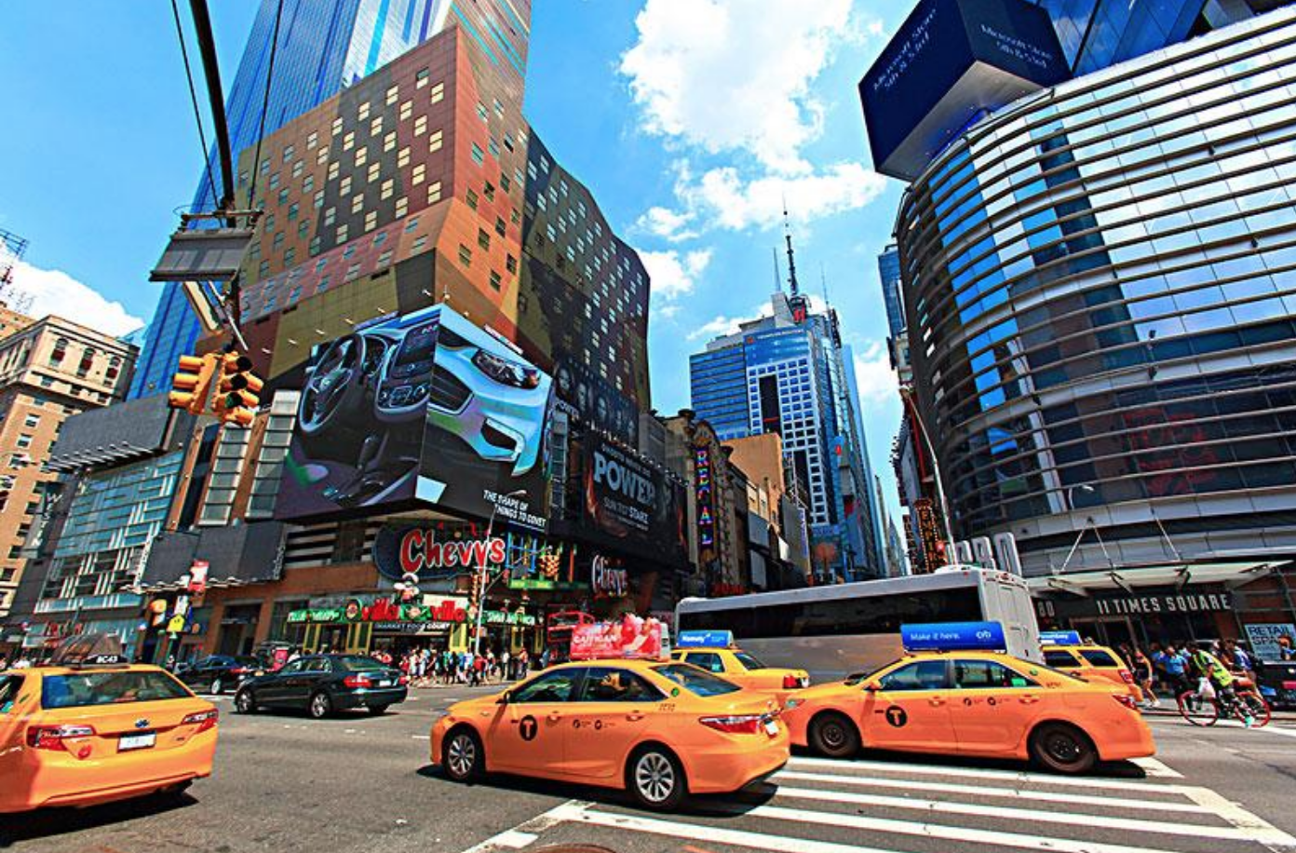
01
Data Description
Dataset About NewYork Taxi Trips

Slide 5
01
Data Description
SOURCE
SIZE
TOOLS
www.kaggle.com
1.78 GB
19 coloumns
12210953 rows
Hadoop
Impala
Tableau

Slide 6
02
PROBLEM STATEMENT

Slide 7
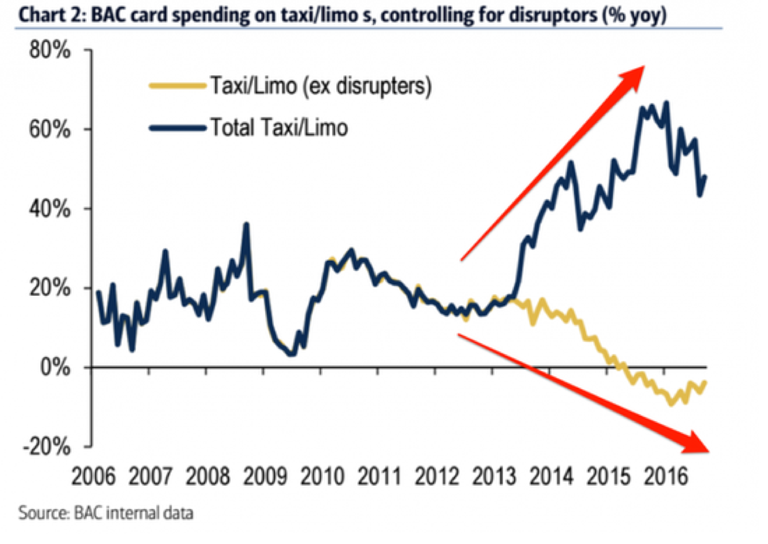
02
Problem Statement
Rising economy
Increasing taxi supply
Declining taxi industry
Solution?

Slide 8
03
Method & Result

Slide 9
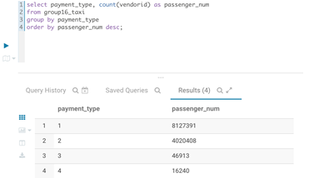
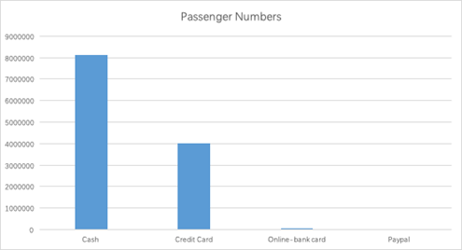
01
Question 1
Which payment method is the most popular for taxi passengers in New York?
1 stands for cash, 2 stands for credit card, 3 stands for online-bank card, 4 stands for Paypal.
The two main payment methods are cash and credit card. Cash payment took the dominant position, reached 8 million times in a single month.
Payment by credit card didn't even reached half of the time of cash payment, by nearly 4 million times.
Online payments like online-bank card and PayPal were only a few compared to cash and credit card, credit card payment was 47000 times and PayPal payment was only about 16000 times.

Slide 10
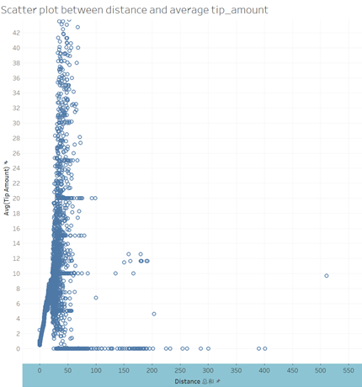
02
Question 2
What is the relationship between the amount of tip and the trip distance?
Select distance, avg(tip_amount) from group16_taxi
group by distance
order by distance asc;
There was a pattern that long-distance trips tend to give none tip that may result from large fare amount make passengers mean with tips.
In short trips, tips are positively related to distance.
There is a large violation in tips given in middle-distance trips.
Overall, below 25 feet, passengers tend to give more tips when distance grows. Between 25 to 50 feet, tips are vary a lot from small amount to large amount. Passengers tend to not give tips when they travel a long distance.

Slide 11
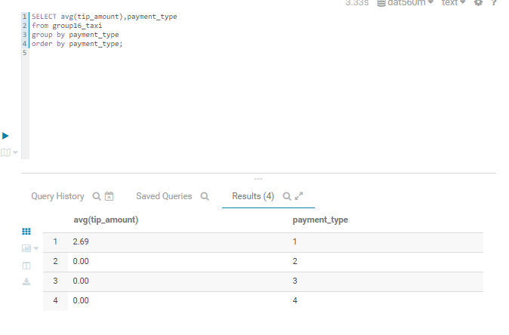
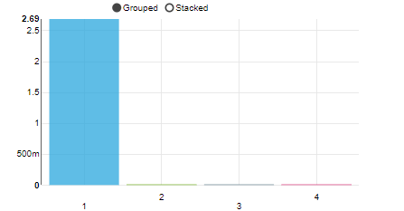
03
Question 3
Whether tip is related to the payment method?
In this question, we used Impala to group the average tip amount by payment type and order the data by the payment_type.
From that conclusion, we can see that the first payment_type ----cash will make taxi drivers get more tips.
Although payment type 2,3,4 will also give tip, on average tends to be 0.

Slide 12
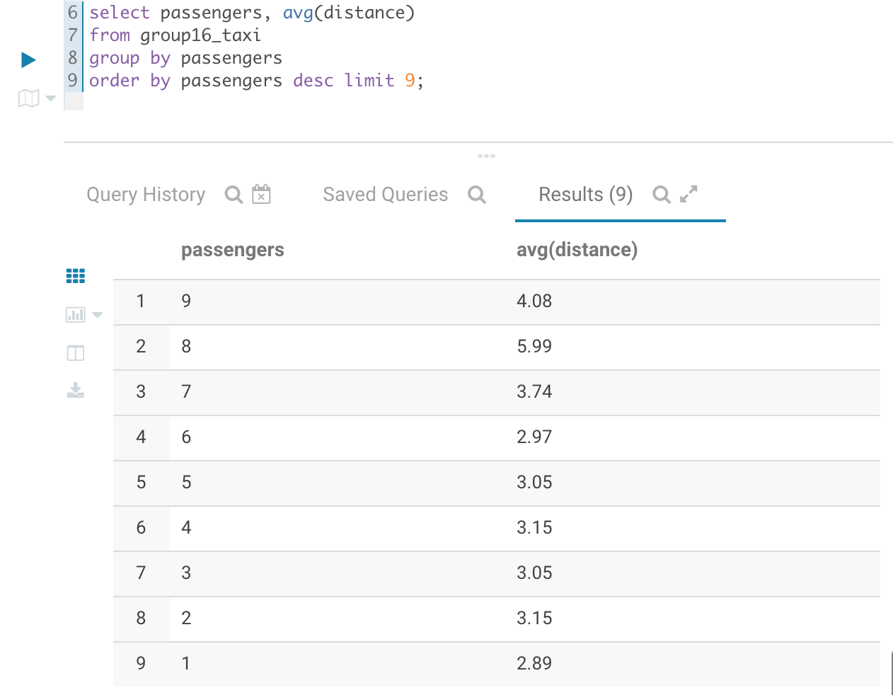
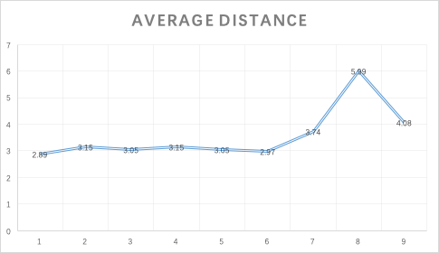
04
Question 4
Is there a relationship between the number of passengers and the trip distance?
Impala is used to execute query about the relationship between trip distance and passenger numbers, Excel is utilized to visualize the dataset.
As the line chart illustrated, passenger numbers between 1-6, these groups of passengers all traveled near 3 miles per car.
When the number comes to 7 or more people in the same car, people in New York are more likely to travel to a further destination.
Among these groups of people, when 8 people take a taxi together, they are likely to take trips around 6 miles, which are nearly doubled compared to trips under 6 people.

Slide 13
04
Conclusion

Slide 14
Take Away
Overview
•Uber not only challenges the traditional taxi business model, but also excels in the passenger experience. So the expenditure on traditional taxis has continued to decline. We aim to use big data tools to analyze trip data to help taxi drivers find some tricks to increase their income such as providing passenger attendance rates and increase received tips.
Data Analysis
•Payment method: cash and credit cards are the most popular payment methods
•Relationship between the amount of tip and the trip distance: long-distance trips tend to give none tip; in short trips, tips are positively related to distance while there is a large violation in tips given in middle-distance trips
•Relationship between tip and the payment method: cash will make taxi drivers get more tips
•Relationship between the number of passengers and the trip distance: if the passenger number is under 6, people tend to take a shorter trip; if the number rises beyond 7 people, they tend to take a longer trip.

Slide 15
Thank you for your listening!

